Slide 1
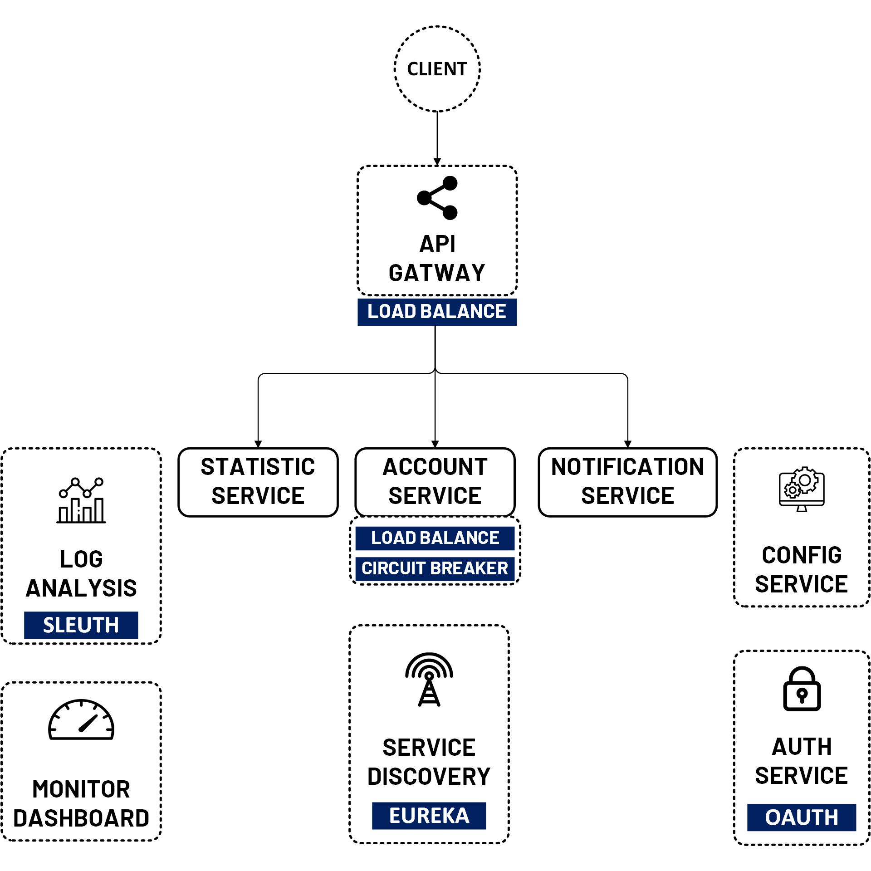

Create Statistic Service with Spring Boot
www.jmaster.io/course/microservices-with-spring-cloud

